Slide 1
MA 207 Day 25
Student t-distribution

Slide 2
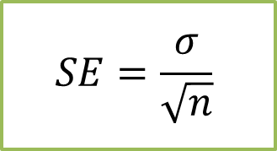
General strategy for computing confidence intervals
Point estimate $±$ margin of error
Point estimate $±$ (# of standard errors)(size of standard errors)
For 1-sample proportions this looks like:
$$\hat{p}±(z_{score})\sqrt{\frac{\hat{p}\left(1−\hat{p}\right)}{N}}$$
For 1-sample means this looks like: (as long as we know $σ)$
$$\overline{x}±(z_{score})∙\frac{σ}{\sqrt{n}}$$
$\overline{x}$ = sample mean
This point estimate comes from the data.
$$SE=\frac{σ}{\sqrt{n}}$$

Slide 3
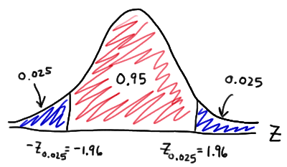
Computing common z-scores
What z-score should capture the middle 90% of data for a standard normal distribution?
What z-score should capture the middle 95% of data for a standard normal distribution?
What z-score should capture the middle 99% of data for a standard normal distribution?
Confidence Level | Tails | z-score
90% confidence interval | Tails = 0.05 | 1.64
95% confidence interval | Tails = 0.025 | 1.96
99% confidence interval | Tails = 0.005 | 2.58

Slide 4
1 sample means
When we know about the underlying population standard deviation, $σ$, we can use the Central Limit Theorem to say that sampling distributions for sample means formed a normal distribution (bell curve) with standard error $SE=\frac{σ}{\sqrt{n}}$, and we could figure out the range for the middle 90% or 95% of samples.
Confidence intervals looked like:
$$sample mean±z_{score}∙\frac{σ}{\sqrt{n}}$$

Slide 5
$σ$ unknown
But what if we are working with a sampling distribution and we don’t know the standard deviation of the underlying population?
Ex) Say I know the amount of time it took for 10 randomly selected students to finish the last stats exam.
I want to create a 95% confidence interval for the average amount of time to finish the exam.
34
28
52
44
40
30
45
39
48
55

Slide 6

$σ$ unknown
But what if we are working with a sampling distribution and we don’t know the standard deviation of the underlying population?
Ex) Say I know the amount of time it took for 10 randomly selected students to finish the last stats exam.
I want to create a 95% confidence interval for the average amount of time to finish the exam.
34
28
52
44
40
30
45
39
48
55
If we knew $σ$, we would create the confidence interval assuming a normal distribution.
$$sample mean±z_{score}∙σ/\sqrt{n}$$

Slide 7
But there is a problem here.
We often don’t know the population standard deviation $σ$ which we need in order to calculate the standard error $SE=σ/\sqrt{n}$ of the sampling distribution for means.
We use the standard deviation, $s$, from the sample to approximate $σ$, but when our sample size is small, $s$ is not an awesome estimator for $σ$.
To address this issue (when $σ$ is unknown), we bring in a new sampling distribution, the t-distribution, which is similar to a z-distribution, but slightly more spread out (i.e. thicker tails).

Slide 8
But there is a problem here.
We often don’t know the population standard deviation $σ$ which we need in order to calculate the standard error $SE=σ/\sqrt{n}$ of the sampling distribution for means.
We use the standard deviation, $s$, from the sample to approximate $σ$, but when our sample size is small, $s$ is not an awesome estimator for $σ$.
To address this issue (when $σ$ is unknown), we bring in a new sampling distribution, the t-distribution, which is similar to a z-distribution, but slightly more spread out (i.e. thicker tails).
Should we give up?

Slide 9
But there is a problem here.
We often don’t know the population standard deviation $σ$ which we need in order to calculate the standard error $SE=σ/\sqrt{n}$ of the sampling distribution for means.
We use the standard deviation, $s$, from the sample to approximate $σ$, but when our sample size is small, $s$ is not an awesome estimator for $σ$.
To address this issue (when $σ$ is unknown), we bring in a new sampling distribution, the t-distribution, which is similar to a z-distribution, but slightly more spread out (i.e. thicker tails).

Slide 10
But there is a problem here.
We often don’t know the population standard deviation $σ$ which we need in order to calculate the standard error $SE=σ/\sqrt{n}$ of the sampling distribution for means.
We use the standard deviation, $s$, from the sample to approximate $σ$, but when our sample size is small, $s$ is not an awesome estimator for $σ$.
To address this issue (when $σ$ is unknown), we bring in a new sampling distribution, the t-distribution, which is similar to a z-distribution, but slightly more spread out (i.e. thicker tails).

Slide 11
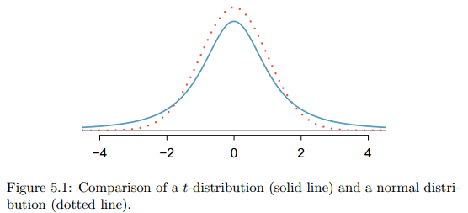
But there is a problem here.
We often don’t know the population standard deviation $σ$ which we need in order to calculate the standard error $SE=σ/\sqrt{n}$ of the sampling distribution for means.
We use the standard deviation, $s$, from the sample to approximate $σ$, but when our sample size is small, $s$ is not an awesome estimator for $σ$.
To address this issue (when $σ$ is unknown), we bring in a new sampling distribution, the t-distribution, which is similar to a z-distribution, but slightly more spread out (i.e. thicker tails).

Slide 12
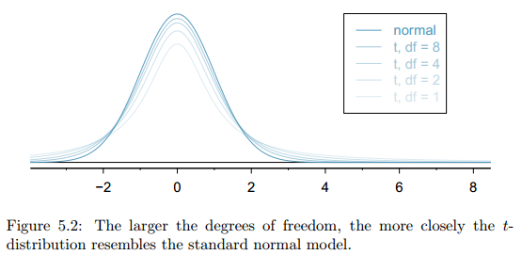
t-distribution
Also, the precise shape of the t-distribution will depend on our sample size n. So the t-distribution is actually a family of mound shaped distributions.

Slide 13
Degrees of freedom
In order to choose which member of the t-distribution family we need, we introduce a new vocab term:
Degrees of freedom (df)
For a sample of size n, the degrees of freedom is $df=n−1$.
The degrees of freedom determine the shape of the t-distribution.
The larger the degrees of freedom, the more closely the distribution approximates the normal model.
When $df≥30$, the t-distribution is nearly identical to the z-distribution.

Slide 14
Back to an example
Ex) Say I know the amount of time it took for 10 randomly selected students to finish the last stats exam. I want to create a 95% confidence interval for the average amount of time to finish the exam.
Find s = sample standard deviation (nearpod)
Find $\overline{x}$ = sample average (nearpod)
Find the degrees of freedom df=n-1 (nearpod)
Find standard error $SE=\frac{s}{\sqrt{n}}$ for samples of size 10 (nearpod)
Confidence interval $\overline{x} ± z_{score}∙\frac{σ}{\sqrt{n}}$
$$\overline{x} ± t_{score}∙\frac{s}{\sqrt{n}}$$
34
28
52
44
40
30
45
39
48
55
Notes:
At this point, class does not yet know how to calculate a t-score. They are learning that they need one and that its slightly different than a z-score.

Slide 15
Degrees of freedom
What exactly is degrees of freedom, and will it always be n-1?
For t-distributions with a single mean, df = n-1, but for other contexts it can take on different values.
What does it mean?

Slide 16
Degrees of freedom
What exactly is degrees of freedom, and will it always be n-1?
For t-distributions with a single mean, df = n-1, but for other contexts it can take on different values.
What does it mean?

Slide 17
A few sample t-dist problems
Let’s try a few probability questions with the t-distribution (Nearpod):
Portion of area left of x
=T.DIST(x= # of st devs, degrees of freedom = df , TRUE)
Example: In order to find the area to the left of -2.50, with df = 12, use Excel command =T.DIST(-2.5,12,true)
Find the portion of the area to the left of -1.30, with df = 12.
Find the portion of the area to the left of -1.30, with df = 24.
Find the portion of the area to the right of 2.30, with df = 10.

Slide 18
A few sample problems
Let’s try a few probability questions with the t-distribution (Nearpod):
Portion of area left of x
=T.DIST(x= # of st devs, degrees of freedom = df , TRUE)
Example: In order to find the area to the left of -2.50, with df = 12, use Excel command =T.DIST(-2.5,12,true)
Find the portion of the area to the left of -1.30, with df = 12.
Find the portion of the area to the left of -1.30, with df = 24.
Find the portion of the area to the right of 2.30, with df = 10.

Slide 19
A few sample problems
Let’s try a few probability questions with the t-distribution (Nearpod):
Portion of area left of x
=T.DIST(x= # of st devs, degrees of freedom = df , TRUE)
Example: In order to find the area to the left of -2.50, with df = 12, use Excel command =T.DIST(-2.5,12,true)
Find the portion of the area to the left of -1.30, with df = 12.
Find the portion of the area to the left of -1.30, with df = 24.
Find the portion of the area to the right of 2.30, with df = 10.

Slide 20
A few sample problems
Let’s try a few probability questions with the t-distribution (Nearpod):
Portion of area left of x
=T.DIST(x= # of st devs, degrees of freedom = df , TRUE)
Example: In order to find the area to the left of -2.50, with df = 12, use Excel command =T.DIST(-2.5,12,true)
Find the portion of the area to the left of -1.30, with df = 12.
Find the portion of the area to the left of -1.30, with df = 24.
Find the portion of the area to the right of 2.30, with df = 10.

Slide 21
A few more sample problems
What if we know the probability for a portion of the t-distribution and we want the cutoff?
Example: In order to find the top 5% of data with df = 12, use the Excel command =T.INV(0.95,12)
Find the cutoffs for the middle 80% of data, with df = 15.
Find the cutoffs for the middle 95% of data, with df = 20.

Slide 22
A few more sample problems
What if we know the probability for a portion of the t-distribution and we want the cutoff?
Example: In order to find the top 5% of data with df = 12, use the Excel command =T.INV(0.95,12)
Find the cutoffs for the middle 80% of data, with df = 15.
Find the cutoffs for the middle 95% of data, with df = 20.

Slide 23
A few more sample problems
What if we know the probability for a portion of the t-distribution and we want the cutoff?
Example: In order to find the top 5% of data with df = 12, use the Excel command =T.INV(0.95,12)
Find the cutoffs for the middle 80% of data, with df = 15.
Find the cutoffs for the middle 95% of data, with df = 20.

Slide 24
When can we use the t-distribution?
The fine print
Independence of observations. We verify this condition just as we did before. We collect a simple random sample from less than 10% of the population, or if the data are from an experiment or random process, we check to the best of our abilities that the observations were independent.
Observations come from a nearly normal distribution. This second condition is difficult to verify with small data sets. We often (i) take a look at a plot of the data for obvious departures from the normal model, and (ii) consider whether any previous experiences alert us that the data may not be nearly normal.

Slide 25
Practice problems: Bears 1
Say we are curious about the average weight of adult black bears in the wild, in Montana.
Option 1: Catch and weigh all adult black bears in Montana.
Option 2: Catch and weigh 12 randomly selected adult black bears in Montana.
Say we find the following 12 weights (in lbs):
240 280 315 180 145 245
260 225 305 365 260 285
Create a 95% confidence interval for the average weight of black bears.
Verify underlying conditions… this is less than 10% of the overall population, and we think the data is randomly selected.
The underlying population is likely nearly normally distributed… Our data doesn’t indicate any extreme skewing.
We don’t know the population standard deviation σ, but we can compute a standard deviation s for the sample of 12 weights. sd(bears)=59.2

Slide 26
Practice problems: Bears 1
Say we are curious about the average weight of adult black bears in the wild, in Montana.
Option 1: Catch and weigh all adult black bears in Montana.
Option 2: Catch and weigh 12 randomly selected adult black bears in Montana.
Say we find the following 12 weights (in lbs):
240 280 315 180 145 245
260 225 305 365 260 285
Create a 95% confidence interval for the average weight of black bears.
Verify underlying conditions… this is less than 10% of the overall population, and we think the data is randomly selected.
The underlying population is likely nearly normally distributed… Our data doesn’t indicate any extreme skewing.
We don’t know the population standard deviation σ, but we can compute a standard deviation s for the sample of 12 weights. sd(bears)=59.2

Slide 27
Practice problems: Bears 1
Say we are curious about the average weight of adult black bears in the wild, in Montana.
Option 1: Catch and weigh all adult black bears in Montana.
Option 2: Catch and weigh 12 randomly selected adult black bears in Montana.
Say we find the following 12 weights (in lbs):
240 280 315 180 145 245
260 225 305 365 260 285
Create a 95% confidence interval for the average weight of black bears.
Verify underlying conditions… this is less than 10% of the overall population, and we think the data is randomly selected.
The underlying population is likely nearly normally distributed… Our data doesn’t indicate any extreme skewing.
We don’t know the population standard deviation σ, but we can compute a standard deviation s for the sample of 12 weights. sd(bears)=59.2
Enter your answer as a complete sentence about bears.

Slide 28
Practice problems: Bears 1
Say we are curious about the average weight of adult black bears in the wild, in Montana.
Option 1: Catch and weigh all adult black bears in Montana.
Option 2: Catch and weigh 12 randomly selected adult black bears in Montana.
Say we find the following 12 weights (in lbs):
240 280 315 180 145 245
260 225 305 365 260 285
Create a 95% confidence interval for the average weight of black bears.
Verify underlying conditions… this is less than 10% of the overall population, and we think the data is randomly selected.
The underlying population is likely nearly normally distributed… Our data doesn’t indicate any extreme skewing.
We don’t know the population standard deviation σ, but we can compute a standard deviation s for the sample of 12 weights. sd(bears)=59.2

Slide 29
Practice problems: Bears 1
Say we are curious about the average weight of adult black bears in the wild, in Montana.
Option 1: Catch and weigh all adult black bears in Montana.
Option 2: Catch and weigh 12 randomly selected adult black bears in Montana.
Say we find the following 12 weights (in lbs):
240 280 315 180 145 245
260 225 305 365 260 285
Create a 95% confidence interval for the average weight of black bears.
Verify underlying conditions… this is less than 10% of the overall population, and we think the data is randomly selected.
The underlying population is likely nearly normally distributed… Our data doesn’t indicate any extreme skewing.
We don’t know the population standard deviation σ, but we can compute a standard deviation s for the sample of 12 weights. sd(bears)=59.2

Slide 30
Practice problems: Bears 1
Say we are curious about the average weight of adult black bears in the wild, in Montana.
Option 1: Catch and weigh all adult black bears in Montana.
Option 2: Catch and weigh 12 randomly selected adult black bears in Montana.
Say we find the following 12 weights (in lbs):
240 280 315 180 145 245
260 225 305 365 260 285
Create a 95% confidence interval for the average weight of black bears.
Verify underlying conditions… this is less than 10% of the overall population, and we think the data is randomly selected.
The underlying population is likely nearly normally distributed… Our data doesn’t indicate any extreme skewing.
We don’t know the population standard deviation σ, but we can compute a standard deviation s for the sample of 12 weights. sd(bears)=59.2

Slide 31
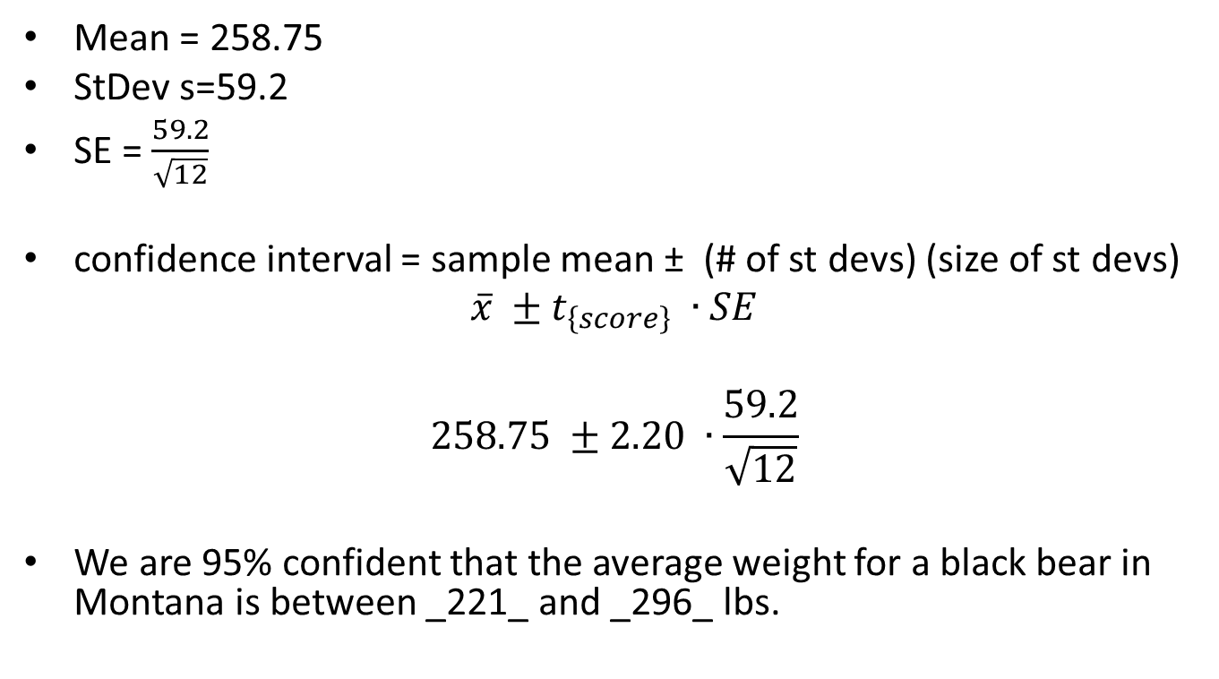
Soln to bears 1
Mean = 258.75
StDev s=59.2
SE = $\frac{59.2}{\sqrt{12}}$
confidence interval = sample mean ± (# of st devs) (size of st devs)
$$\overline{x} ±t_{\left\{score\right\}} ∙SE$$
$$258.75 ±2.20 ∙\frac{59.2}{\sqrt{12}}$$
We are 95% confident that the average weight for a black bear in Montana is between _221_ and _296_ lbs.

Slide 32
Soln to bears 1
Mean = 258.75
StDev s=59.2
SE = $\frac{59.2}{\sqrt{12}}$
confidence interval = sample mean ± (# of st devs) (size of st devs)
$$\overline{x} ±t_{\left\{score\right\}} ∙SE$$
$$258.75 ±2.20 ∙\frac{59.2}{\sqrt{12}}$$
We are 95% confident that the average weight for a black bear in Montana is between _221_ and _296_ lbs.
Does this mean that 95% of black bears are between 221 lbs and 296 lbs? Explain your reasoning. (Nearpod)

Slide 33
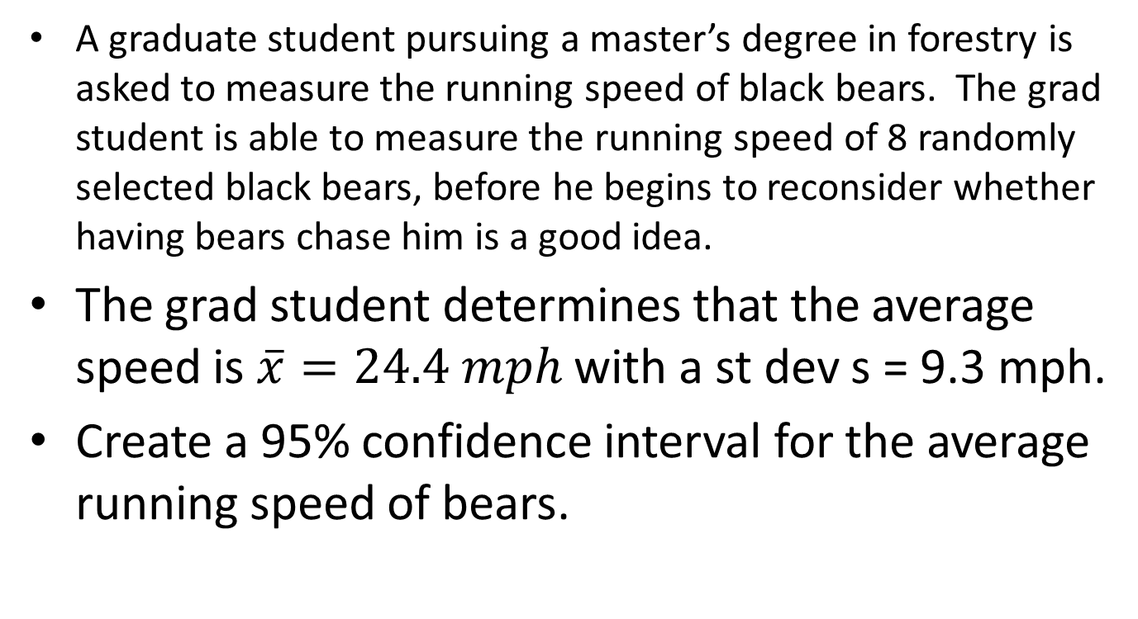
Bears 2
A graduate student pursuing a master’s degree in forestry is asked to measure the running speed of black bears. The grad student is able to measure the running speed of 8 randomly selected black bears, before he begins to reconsider whether having bears chase him is a good idea.
The grad student determines that the average speed is $\overline{x}=24.4 mph$ with a st dev s = 9.3 mph.
Create a 95% confidence interval for the average running speed of bears.

Slide 34
Bears 2
A graduate student pursuing a master’s degree in forestry is asked to measure the running speed of black bears. The grad student is able to measure the running speed of 8 randomly selected black bears, before he begins to reconsider whether having bears chase him is a good idea.
The grad student determines that the average speed is $\overline{x}=24.4 mph$ with a st dev s = 9.3 mph.
Create a 95% confidence interval for the average running speed of bears.
Explain what this interval means, in your own words.

